Slide 1
A Revolutionary Healthcare Platform
Dual Interfaces for Doctors and Patients
Presenter- Kulwinder Kaur

Slide 2
ABOUT TRAINING
Training : Web Development
Languages : HTML, CSS, BS, PHP, MYSQL
Training : Solitaire Infosys
Duration : Six weeks

Slide 3

Introduction to php:
PHP stands for hypertext preprocessor.
PHP is a server-side web scripting language , which executes on the web server.
PHP can be embedded in HTML.
PHP used to generate dynamic web pages.

Slide 4
Introduction to project
PROBLEM
PROJECT
SOLUTION

Slide 5
“Problems: The Current State of Healthcare"
Long wait times for appointments
Difficulty in finding the right doctor
Lack of transparency in medical records
Inefficient communication between doctors and patients

Slide 6
"Our Solution: A Comprehensive Doctor-Patient Platform"
Easy appointment scheduling
Verified doctor profiles
Secure and transparent medical records
Real-time communication and messaging

Slide 7

Overview
Welcome to Medical Website, your comprehensive platform for all your healthcare needs. Our website is designed to make your healthcare experience smooth and efficient. We offer two different login interfaces, one for doctors and one for patients, to cater to your specific needs.

Slide 8

Key features:
Secure login for doctors and patients
Easy navigation and user-friendly interface
Comprehensive patient records management
Appointment scheduling system
Secure Messaging
Prescription management

Slide 9
module
DOCTORS & PATIENTS

Slide 10

PATIENT AND DOCTOR MODULE
AUTHORIZATION
SERVICES(DOCTORS)
DOCTOR DETAIL
BOOKING
VIEW(APPROVED/PENDING)
MESSAGE

Slide 11
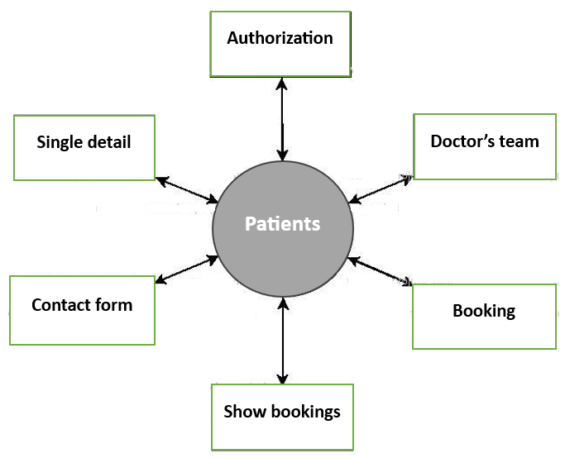
DFD DIAGRAMS:
For patient

Slide 12
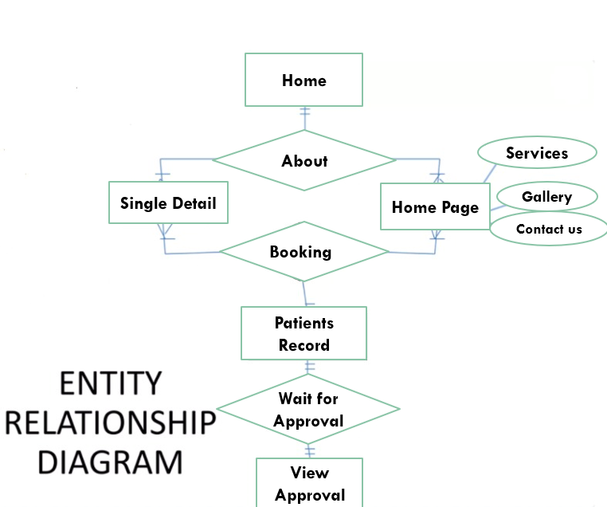
DETAILED DFD FOR PATIENT:

Slide 13

DFD FOR DOCTOR:
Doctor
Login
Approval

Slide 14
RESULT:

Slide 15
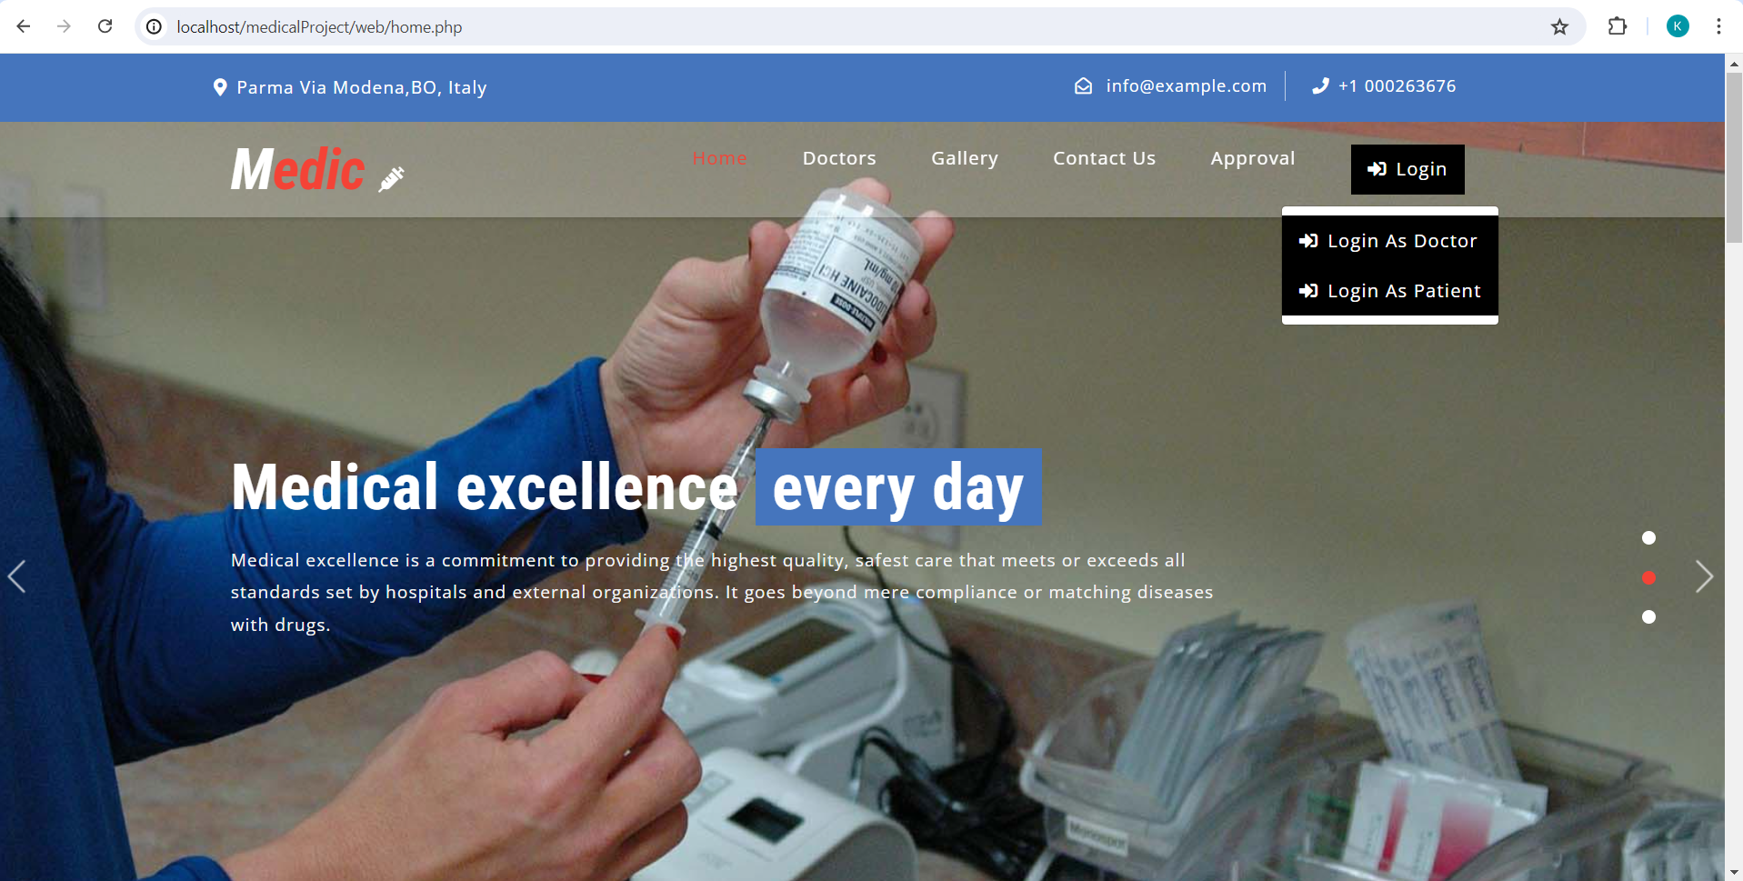
HOME

Slide 16
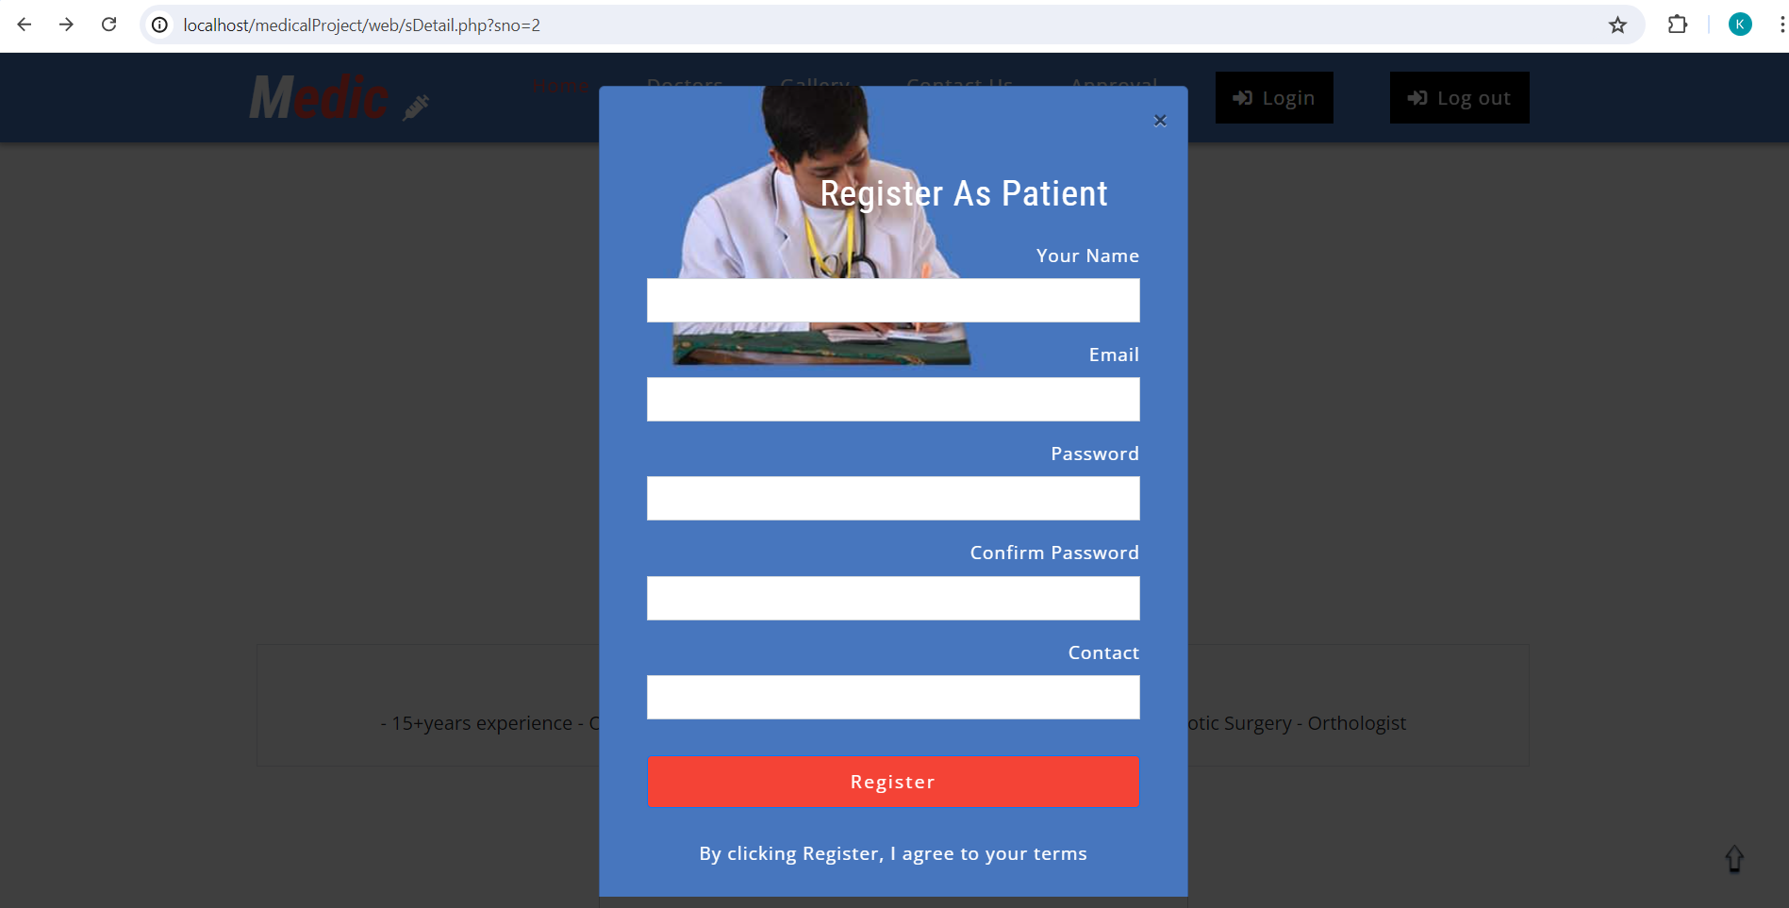
Patient’s registration form

Slide 17
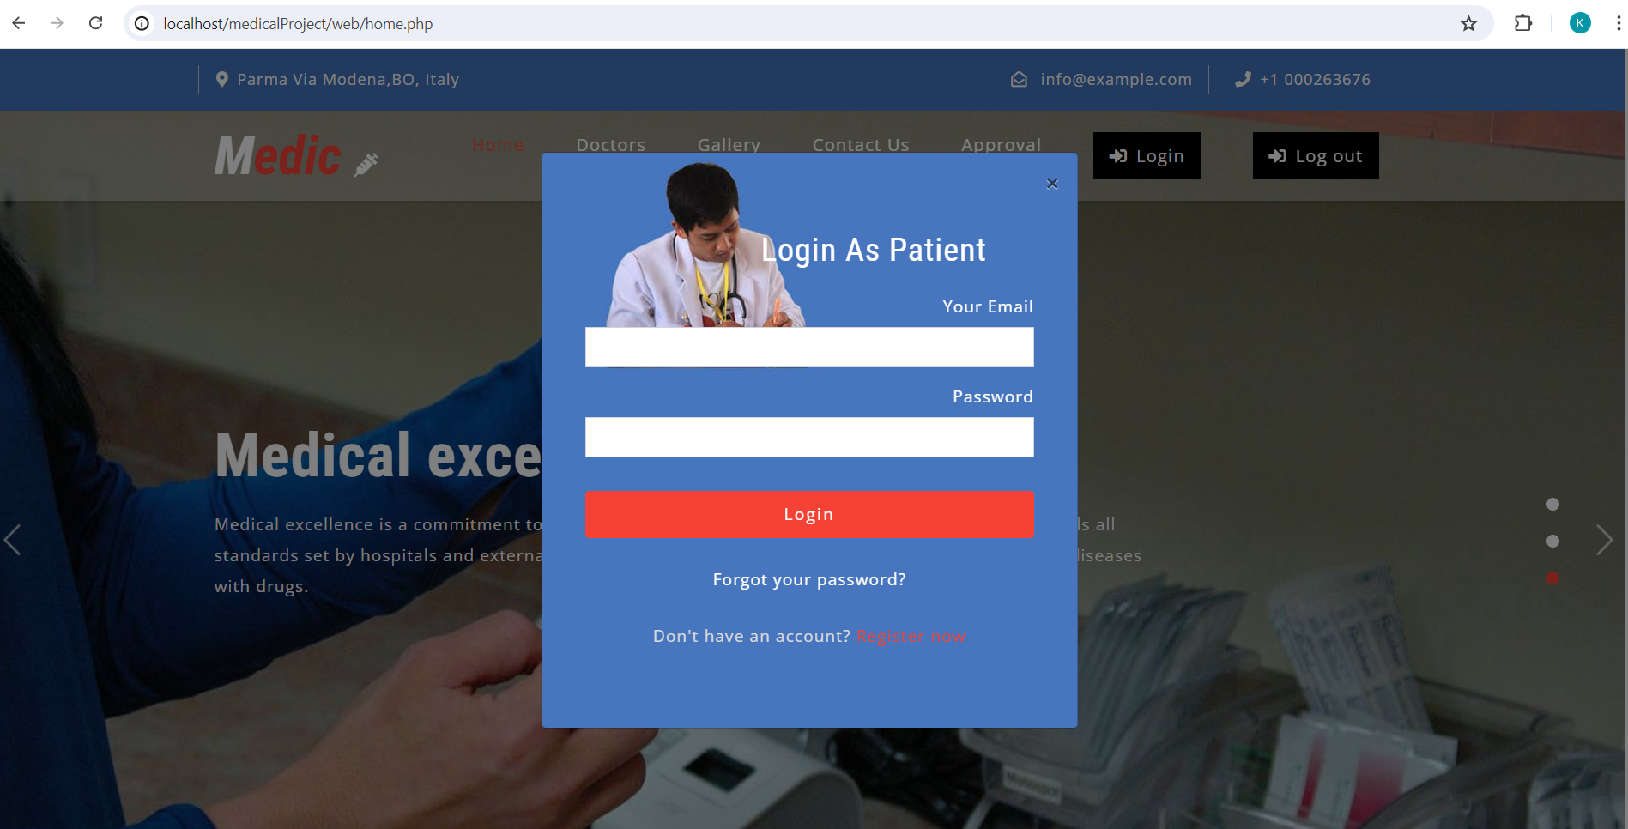
Patient’s login

Slide 18
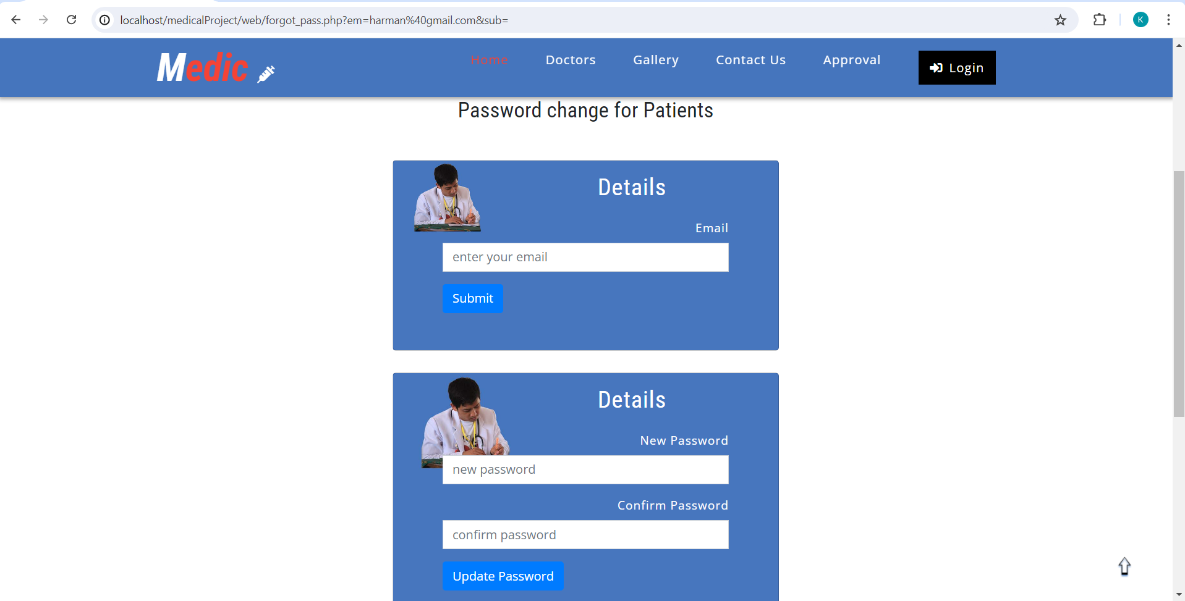
Password change

Slide 19
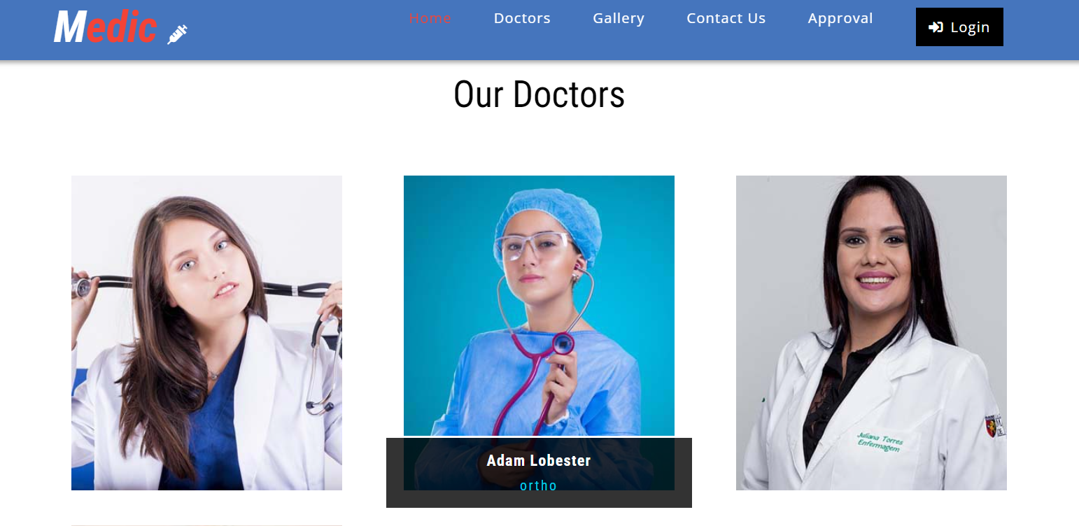
OUR DOCTOR’S TEAM:

Slide 20
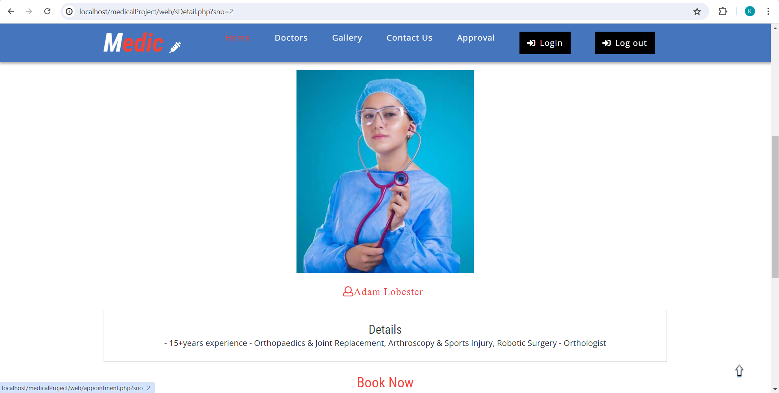
DOCTOR’S DETAIL

Slide 21
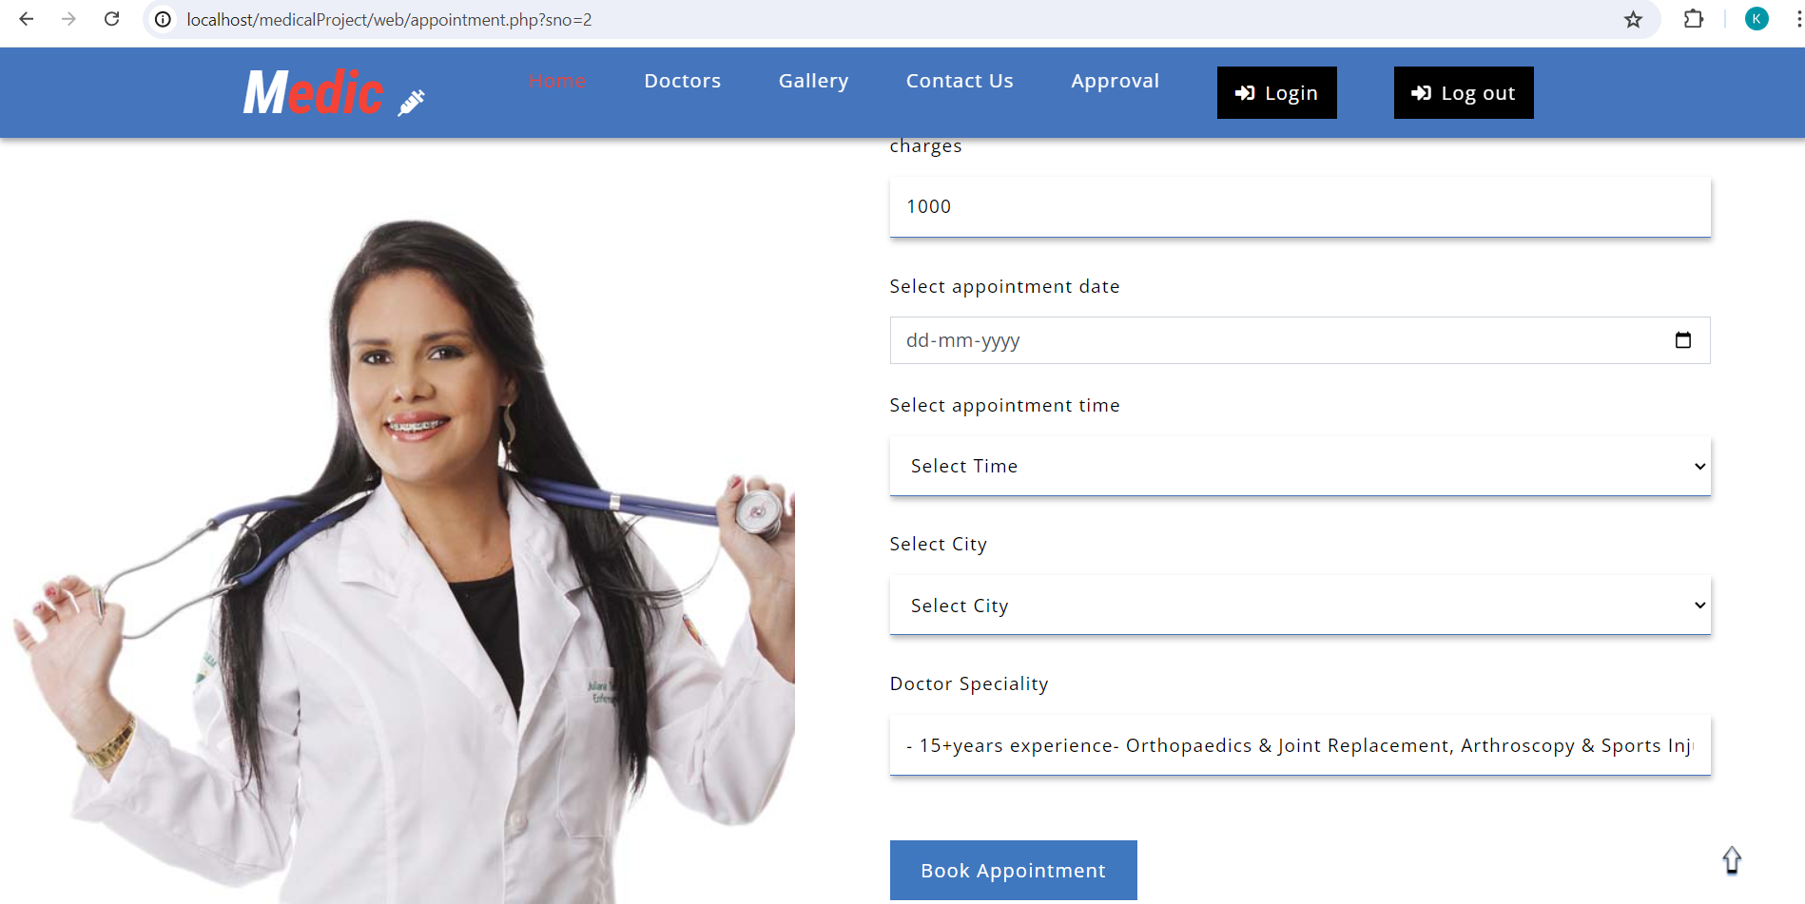
Appointment page

Slide 22
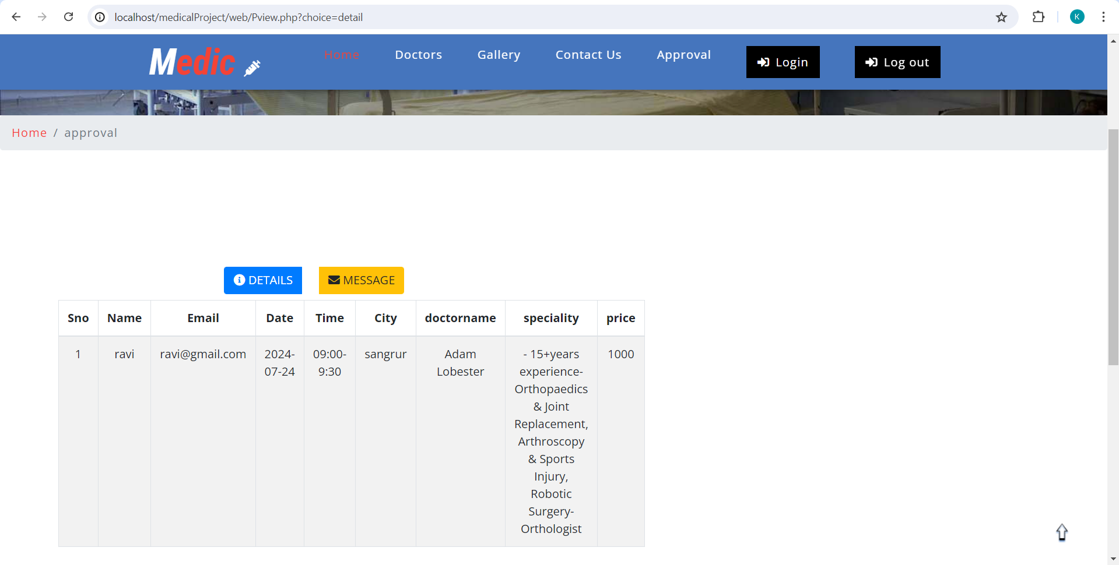
PATIENT’S VIEW PAGE: include details

Slide 23
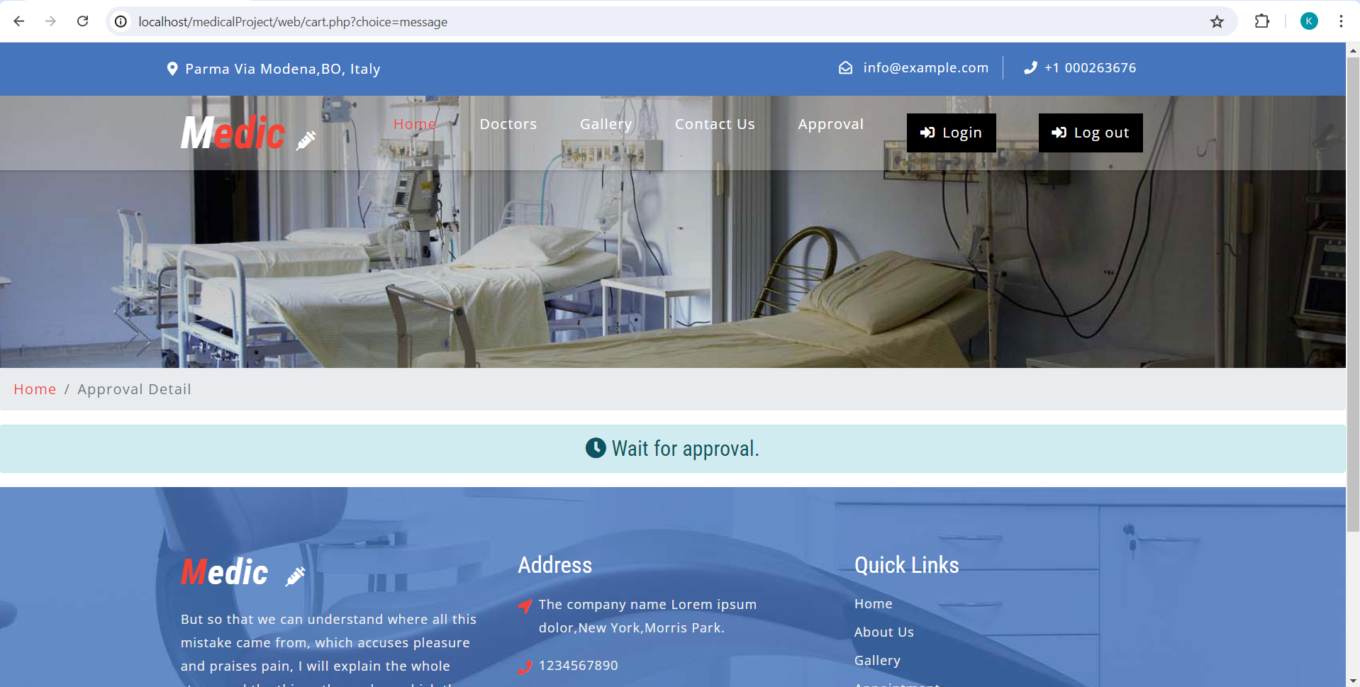
Patient’s view page: show booking messages

Slide 24
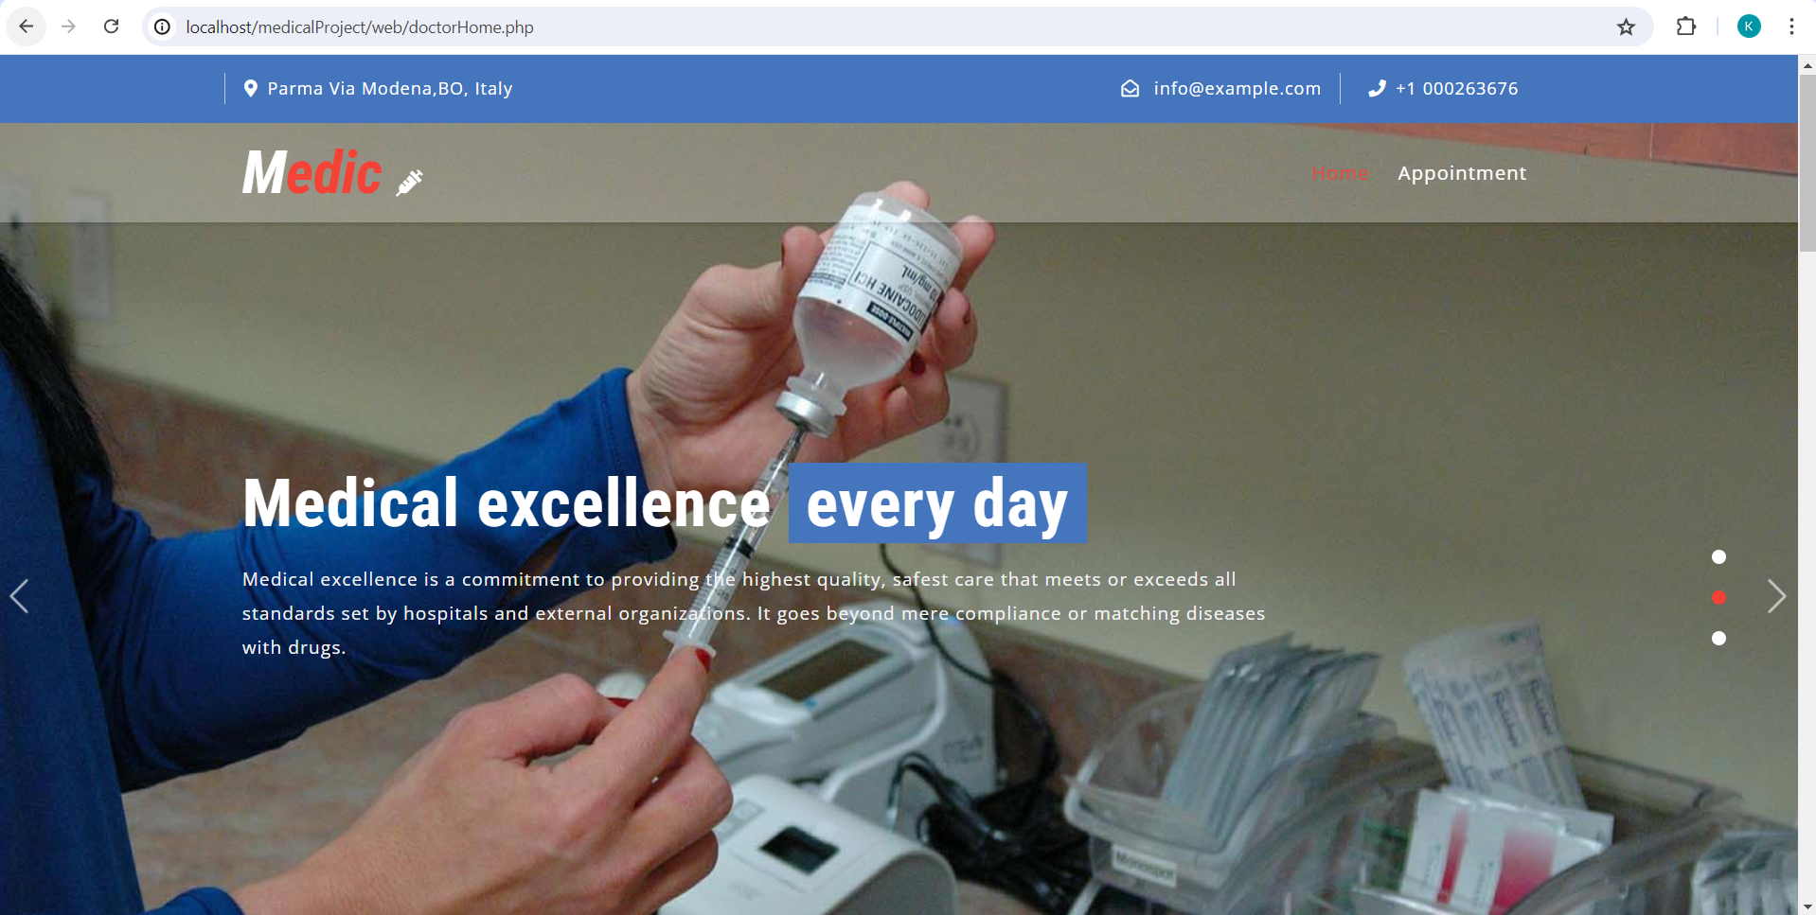
DOCTOR’S HOME

Slide 25
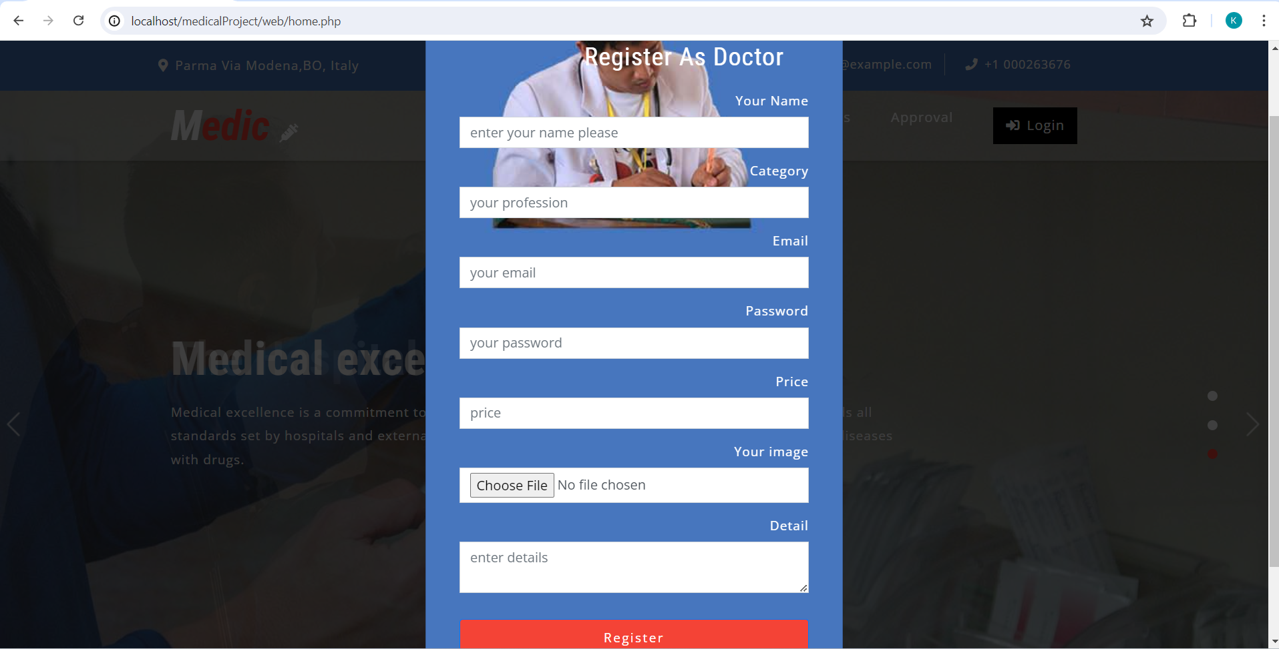
Registration for doctors

Slide 26
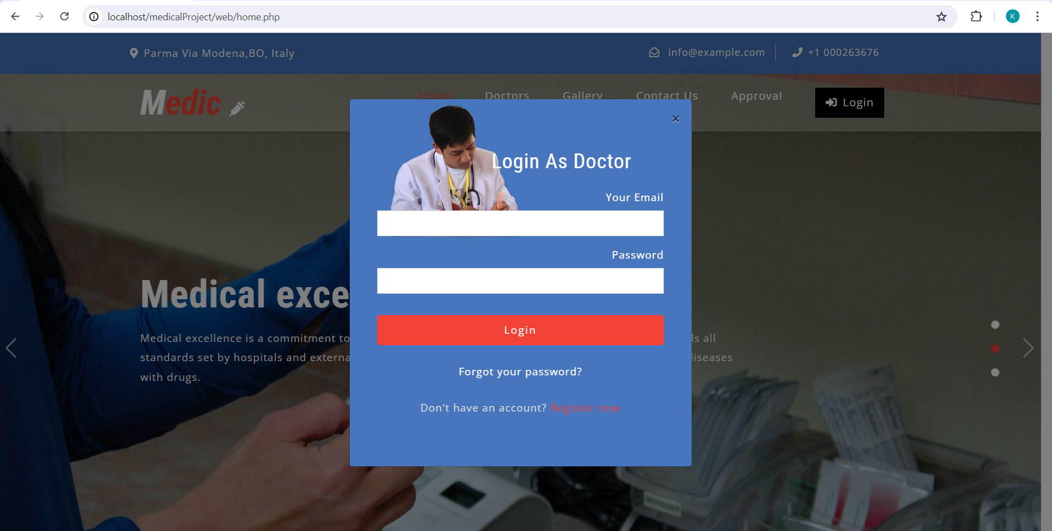
Login for doctors

Slide 27
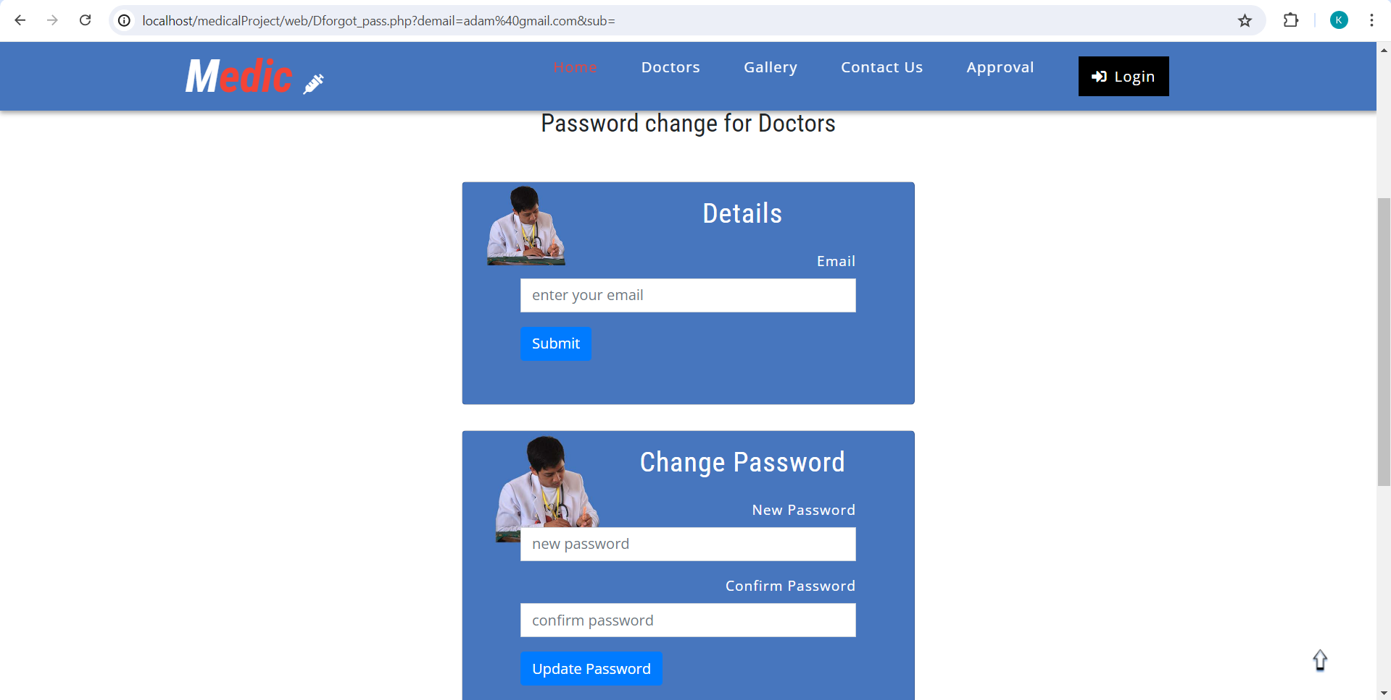
Password change

Slide 28
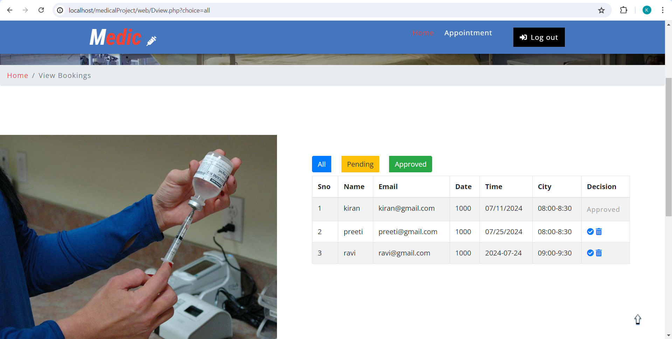
DOCTOR’S APPOINTMENT: all appointments

Slide 29
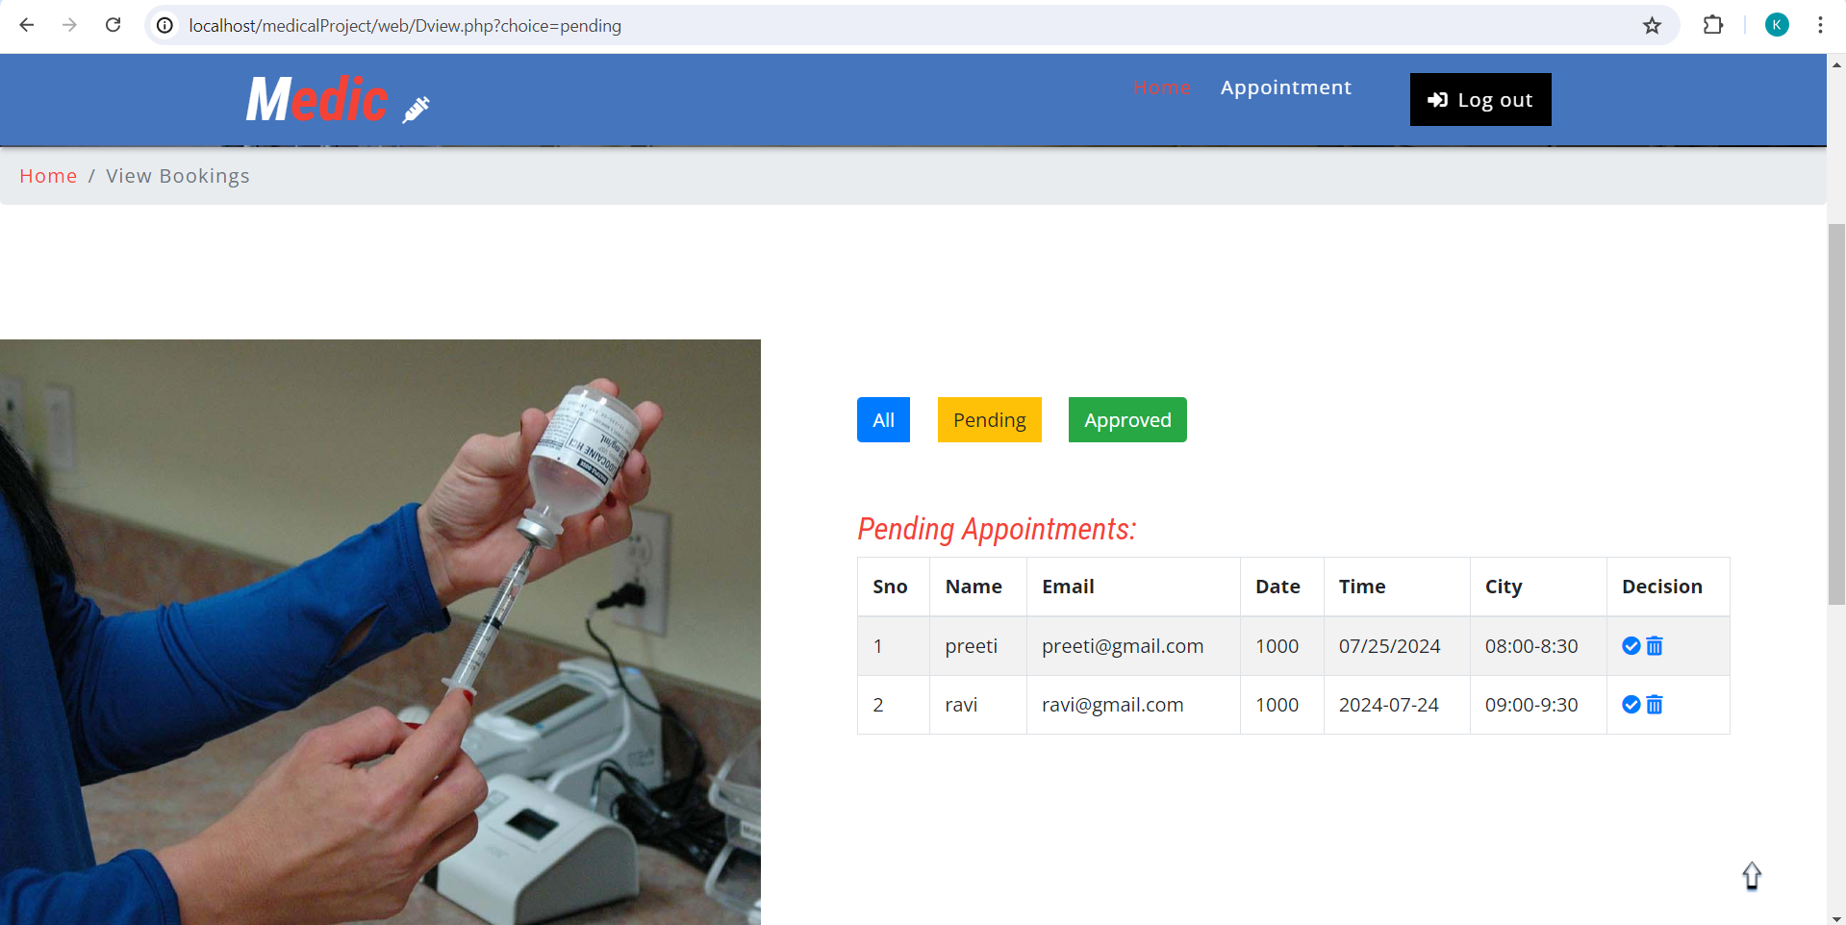
Show pending appointments

Slide 30
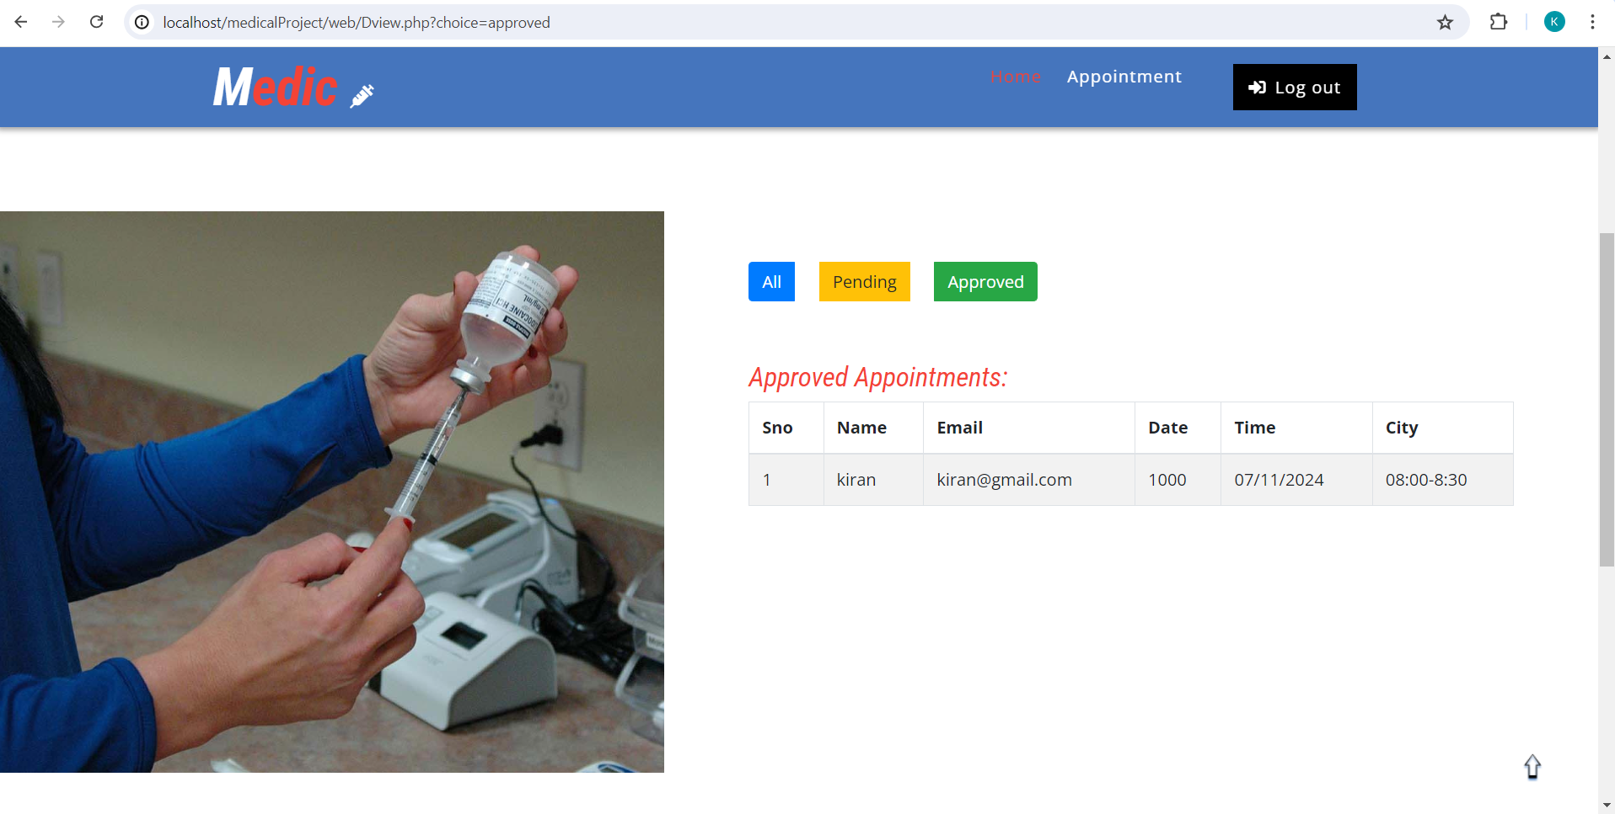
Show approved appointments

Slide 31
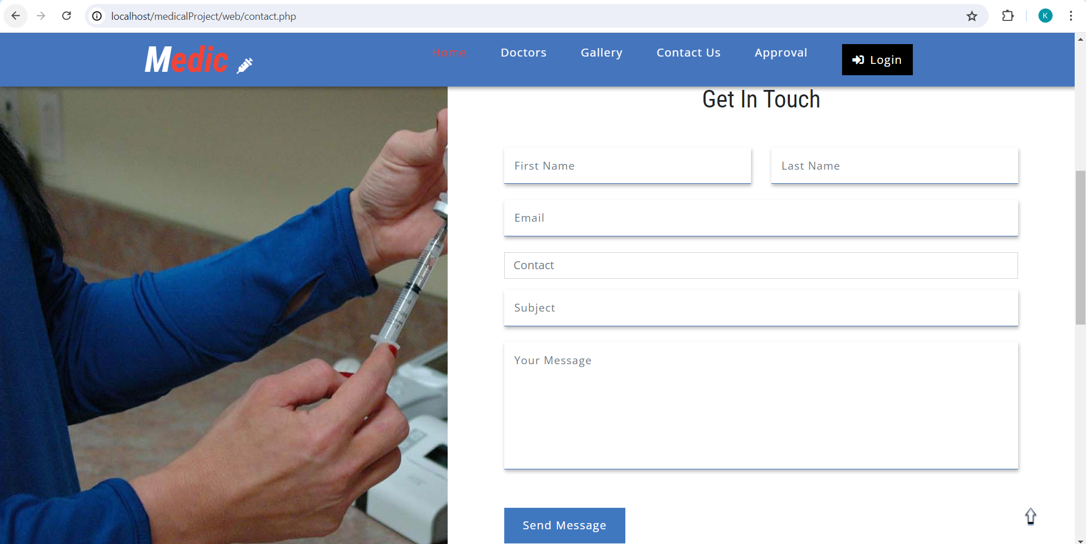
Contact us

Slide 32
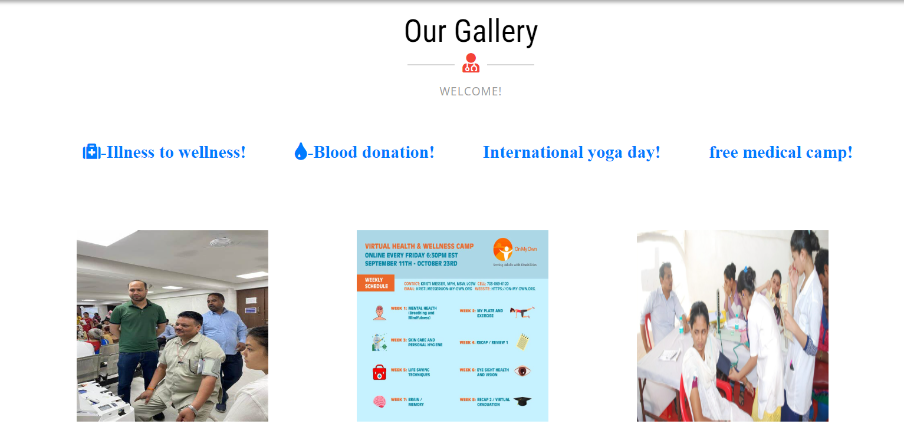
GALLERY

Slide 33
The Benefits of Our Platform
Increased doctor efficiency
Enhanced patient engagement
Better communication and transparency
Improved patient outcomes

Slide 34

Thank you

